Slide 1






PDS
Computer Vision
Cloud Computing
@ P. Siagian
https://github.com/siagianp
https://www.youtube.com/@AmelOline/videos
https://github.com/amelcharolinesgn2/IoT_simulator-mqtt-NodeRed
https://github.com/amelcharolinesgn2/Cloud-Infrastructures
https://github.com/amelcharolinesgn2/ClouD-Infrastructure-SISKA-2025
https://github.com/amelcharolinesgn2/Gyroscope-Sensor-Data-Accelerometer
https://github.com/amelcharolinesgn2/cloudSim
https://github.com/amelcharolinesgn2/CCNA 1
Notes:
data communication simulator
https://github.com/yetanalytics/datasim
Quantum Communication Simulator
https://github.com/Slygriyrsk/quantum-communication-simulator
MIL-STD-1553-Simulator
MIL-STD-1553 is a serial communication protocol that is used in spacecrafts for internal communication. A spacecraft consists of various components like main computer, star tracker, fly wheel, temperature sensor, cameras (also called as Remote Terminals) etc. The main computer needs to communicate with all the other peripherals to get the data and send it to ground station for further processing. This internal communication is done by a serial bus called MIL-STD-1553. This repository contains a simulation for this protocol. It can be used to create any space applications by importing the simulator into your code.
MIL-STD-1553 has Bus Controller that orchestrates the transmission and reception of data on the serial bus. It always initiates the communication and commands Remote Terminal for sending or receiving data. Only one node or Remote Terminal can send data on the bus at a given moment when ordered by the Bus Controller. The details of the protocol can be found in MIL-STD-1553 Tutorial and Reference document by Alta dt.
About This Repository:
This repository segregated based on various components that are described in the MIL-STD-1553 standard. Two of the most important components are Bus Controller and Remote Terminals. For a small network, one serial bus can handle up to 31 remote terminals and one bus controller. This repository is divided into two parts. Bus Controller Simulator and Remote Terminal Simulator. Both the components have separate set of functionalities.
Bus Controller Simulator : This simulator is responsible to understand the requirements from the Flight Software or Spacecraft computer and send commands and data to Remote Terminal.
Remote Terminal Simulator : This simulator is responsible for understanding the commands or data comming from the Bus Controller and send status and data based on the requirements sent by the Bus Controller.
How To Use This Simulator
https://github.com/ShubhankarKulkarni/MIL-STD-1553-Simulator
This simulator uses ethernet communication instead of the actual physical communication that is mentioned in the standars. The standard is developed taking harsh and noisy conditions into account. The simulator majorly focuses on data layer of the standard. Based on this, you can either deploy both the simulators on the same machine and test it over the local loopback or you can deploy separate simulators on separate machines in a single subnet or same network.
You can run the following commands to run the simulators
python BC_Simulator.py
python RT_Simulator.py
python Simulator.py
Or you can uncomment a section of code in Simulator.py that creates threads for Bus Controller Simulator and Remote Terminal Simulator and then run the following command
python Simulator.py
Simulator.py only provides an example of how you can use BC and RT simulators. You can replace Simulator.py by any space application that needs to transfer any data using MIL-STD-1553. Apart from that, this whole repository is developed as a module. So, you can simply clone the repository into your application and can import it.
Arikatakur/Network-Transmission-Simulator
https://github.com/Arikatakur/Network-Transmission-Simulator
imulates network data transmission using the Stop-and-Wait protocol with acknowledgment packets. It includes:
Theoretical Calculator: Computes the time required to send a file under ideal conditions.
UDP File Transfer Tools: Sends files over a network using UDP and logs transmission details.
Experimentation Framework: Measures and compares theoretical vs. actual transmission times.
Features
Command-line interface for both theoretical calculations and actual file transmission.
Logs packet transmission details, acknowledgments, and final results.
Javadoc documentation for all classes and methods.
Test cases for robust verification.
Requirements
Java Development Kit (JDK) version 8 or higher.
Two computers on the same network for experimentation.
Tools:
iperf for bandwidth measurement.
Wireshark for packet analysis.
Design of data communication networks using simulation techniques
A Simulator for FANETs Using 5G Vehicle-to-Everything Communications and Named-Data Networking
https://arxiv.org/html/2510.13823v1

Slide 2
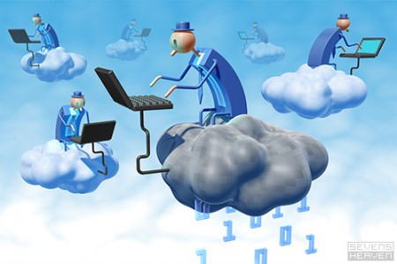
Introduction to Cloud Computing, Virtualization and CloudSim

Slide 3
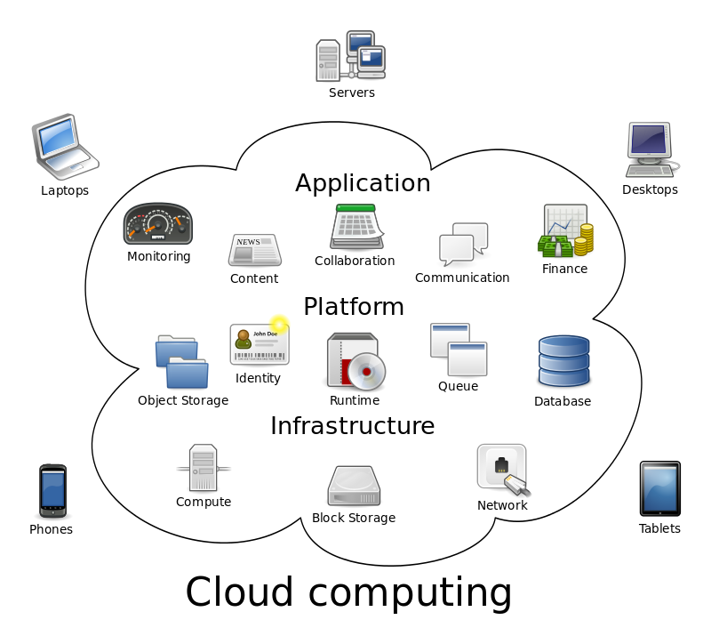
The Next Revolution in IT
The Big Switch in IT
Cloud Computing
  Subscribe
  Use
  $ - pay for what you use, based on QoS
Classical Computing
  Buy & Own
    Hardware, System Software, Applications often to meet peak needs.
  Install, Configure, Test, Verify, Evaluate
  Manage
  ..
  Finally, use it
  $$$$....$(High CapEx)
Every 18 months?

Slide 4

.
Definition : Cloud Computing
Defination for laymen: https://www.youtube.com/watch?v=AnxrJiS5uKU
Cloud
Computing
The “Cloud” is the default symbol of the internet in diagrams.
The broader term of “Computing” encompasses:
Computation
Coordination logic
Storage
Cloud Computing is about moving computing from the single desktop pc/data centers to the internet.

Slide 5
.
Defining Clouds: There are many views for what is cloud computing?
NIST DEFINITION:
  Accoprding to NIST Special Publication 800-145, “Cloud computing is a model for enabling ubiquitous, convenient, on-demand network access to a shared pool of configurable computing resources (e.g. Networks, storage, memory, servers, applications, services etc.) that can be rapidly provisioned and de-provisioned with minimal management effort or service provider interaction.”
Buyya’s Scientific definition of Cloud Computing ☺
  “Cloud is a market-oriented distributed computing system consisting of a collection of inter-connected and virtualised computers that are dynamically provisioned and presented as one or more unified computing resources based on service-level agreements (SLAs) established through negotiation between the service provider and consumers.”
  SLA = {negotiated and agreed QoS parameters + rewards + penalties for violation of agreement....}

Slide 6
.
Cloud Computing : Buzzword
QoS
SaaS
Amazon EC2
Virtualization
IaaS
Amazon S3
.
Storage
PaaS
Billing
Pricing
Web Services
VMWare
Resource Metering
Service Level
Agreement
Hypervisors
Utility Computing
Provisioning
on Demand
Security
Public Cloud
Manjrasoft Aneka
Web 2.0
Privacy
Uhm, I am not quite
clear…Yet another
buzzword..?
Private Cloud
Enterprise Cloud
Google AppEngine
SalesForce.com
Mosso

Slide 7
.
When Should I say service is a Cloud?
Metering
Elastic in nature
Dynamic Provisioning
Scalable in nature
On Demand Access
Any Time any where
Accessible through API or browser

Slide 8






Rentable Cloud Services
Infrastructure as a Service (IaaS)
  CPU, Storage: Amazon.com, Nirvanix, GoGrid….
Platform as a Service (PaaS)
  Google App Engine, Microsoft Azure, Manjrasoft Aneka..
Software as a Service (SaaS)
  SalesForce.Com
Software as a Service (SaaS)
Platform as a Service (PaaS)
Infrastructure as a Service (IaaS)
....

Slide 9
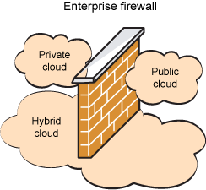
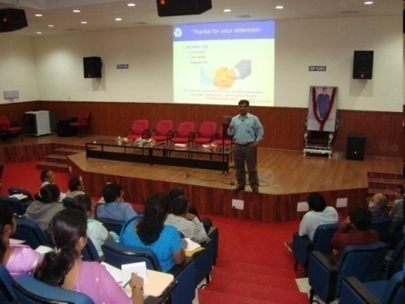

Cloud Deployment Models
Public/Internet Clouds
Private/Enterprise Clouds
Hybrid/Inter
Clouds
3rd party,
multi-tenant Cloud
infrastructure
& services:
* available on
subscription basis
Cloud model run
within a company’s
own Data Center /
infrastructure for
internal and/or
partners use.
Mixed usage of
private and public
Clouds: Leasing public
cloud services
when private cloud
capacity is
insufficient

Slide 10
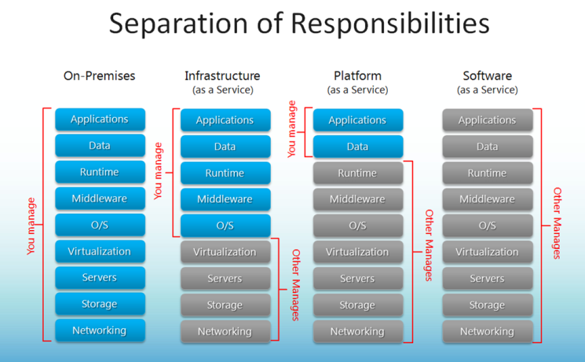
Responsibilities of each stake holder
Credit:http://robertgreiner.com/2014/03/windows-azure-iaas-paas-saas-overview/

Slide 11
.
Enabling Technologies for cloud
Virtualization Virtualization.ppt
Distributed Computing
Mainframes
Cluster Computing
Grid Computing
Cloud Computing
Fog Computing
Edge Computing

Slide 12
.
Introduction
Definition - What does Virtualization mean?
Virtualization refers to the creation of a virtual resource such as a server, desktop, operating system, file, storage or network.
Allows creation of secure, customizable and isolated execution environment for running applications.
Windows or Linux
Virtualization provides an abstract environment.
Example-Hardware virtualization.
Programming level
Application level
Operating system level

Slide 13
.
Taxonomy of Virtualization Techniques
Virtualization is mainly used to emulate execution environment , storage and networks.
Execution Environment classified into two :
– Process-level – implemented on top of an existing operating system.
– System-level – implemented directly on hardware and do not or minimum requirement of existing operating system

Slide 14
.
Machine Reference Model
It defines the interfaces between the levels of abstractions, which hide implementation details.
Virtualization techniques actually replace one of the layers and intercept the calls that are directed towards it.

Slide 15
.
Machine Reference Model
Applications
Applications
API calls
API
Libraries
Libraries
ABI
System calls
User
ISA
User
ISA
Operative System
Operative System
ISA
ISA
Hardware
Hardware

Slide 16
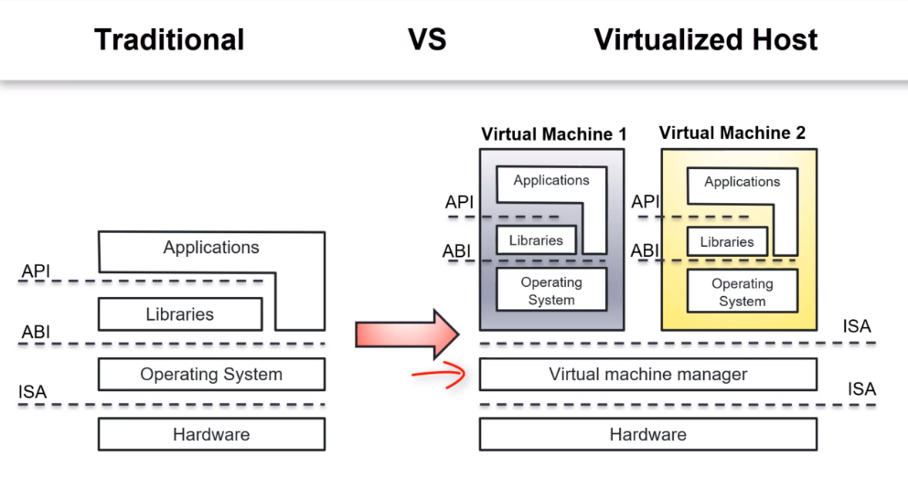

Slide 17
.
Hypervisor
Hypervisor runs above the supervisor mode.
It runs in supervisor mode.
It recreates a h/w environment.
  It is a piece of s/w that enables us to run one or more VMs on a physical server(host).
  Two major types of hypervisor -
  – Type –I
  – Type-II

Slide 18
.
Type-I Hypervisor
Type-I Hypervisor
It runs directly on top of the hardware.
Takes place of OS.
Directly interact with the ISA exposed by the underlying hardware.
Also known as native virtual machine or bare metal virtualization.

Slide 19
.
Type-II Hypervisor
Type-II Hypervisor
It require the support of an operating system to provide virtualization services.
Programs managed by the OS.
Emulate the ISA of virtual h/w.
Also called hosted virtual machine.

Slide 20
.
Type-I & Type-II Hypervisors
VM
VM
VM
VM
ISA
Virtual Machine Manager
VM
VM
VM
VM
ABI
ISA
Operative System
Virtual Machine Manager
ISA
ISA
Hardware
Hardware

Slide 21
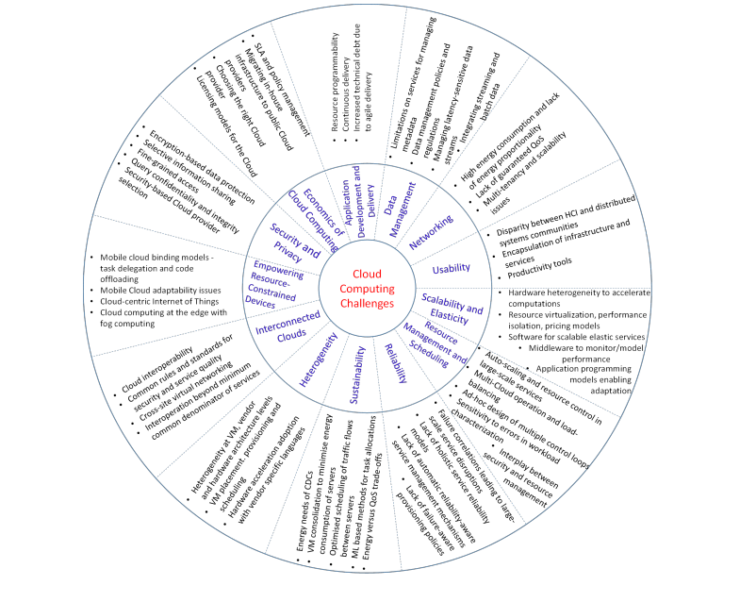
Research Scope

Slide 22
Limitations and Disadvantages
According to Bruce Schneier, "The downside is that you will have limited customization options.
Cloud computing is cheaper because of economics of scale, and—like any outsourced task—you tend to get what you want. A restaurant with a limited menu is cheaper than a personal chef who can cook anything you want. Fewer options at a much cheaper price: it's a feature, not a bug."
He also suggests that "the cloud provider might not meet your legal needs" and that businesses need to weigh the benefits of cloud computing against the risks. In cloud computing, the control of the back end infrastructure is limited to the cloud vendor only. Cloud providers often decide on the management policies, which moderates what the cloud users are able to do with their deployment. Cloud users are also limited to the control and management of their applications, data and services. This includes data caps, which are placed on cloud users by the cloud vendor allocating certain amount of bandwidth for each customer and are often shared among other cloud users.
Privacy and confidentiality are big concerns in some activities.
Cloud computing is beneficial to many enterprises; it lowers costs and allows them to focus on competence instead of on matters of IT and infrastructure. Nevertheless, cloud computing has proven to have some limitations and disadvantages, especially for smaller business operations, particularly regarding security and downtime.
Since this technology's systems rely on the internet, an individual cannot be able to access their applications, server or data from the cloud during an outage.

Slide 23
Simulation Tool
Cloud Simulator (CloudSim)
Prerequisites
  CloudSim 3.0.3 (https://github.com/Cloudslab/cloudsim/releases/tag/cloudsim-3.0.3)
  JDK (Preferably latest version) (https://www.oracle.com/technetwork/java/javase/downloads/index.html)
  Eclipse IDE or Netbeans (https://www.eclipse.org/downloads/packages/release/oxygen)
  Commons Math3 3.6.1 (commons-math3-3.6.1.jar) (http://commons.apache.org/proper/commons-math/download_math.cgi)

Slide 24
Why CloudSim ?
Support for modeling and simulation of large-scale Cloud computing environments, including data centers, on a single physical computing node(could be a desktop, laptop, or server machine).
A self-contained platform for modeling Clouds, service brokers, provisioning, and allocation policies.
Facilitates the simulation of network connections across the simulated system elements.
Facility for simulation of federated Cloud environment that inter-networks resources from both private and public domains, a feature critical for research studies related to Cloudbursts and automatic application scaling.
Availability of a virtualization engine that facilitates the creation and management of multiple, independent, and co-hosted virtualized services on a data center node.
Flexibility to switch between space-shared and time-shared allocation of processing cores to virtualized services.

Slide 25
What CloudSim?
Several simulators can be used to simulate the working of new services, among them CloudSim Simulation Toolkit is the more generalized and effective simulator for testing Cloud computing-related hypothesis.
CloudSim is an extensible simulation framework developed by a team of researchers(under the guidance of Dr. Raj Kumar Buyya) at Cloud Computing and Distributed Systems (CLOUDS) Laboratory, University of Melbourne.
This toolkit allows seamless modeling, simulation, and Experimentation related to cloud-based infrastructures and application services and its various released versions are published on Cloudsim’s GitHub project page.
This simulation toolkit allows the researchers as well as cloud developers to test the performance of the potential cloud application for performance testing in a controlled and easy to setup environment.

Slide 26
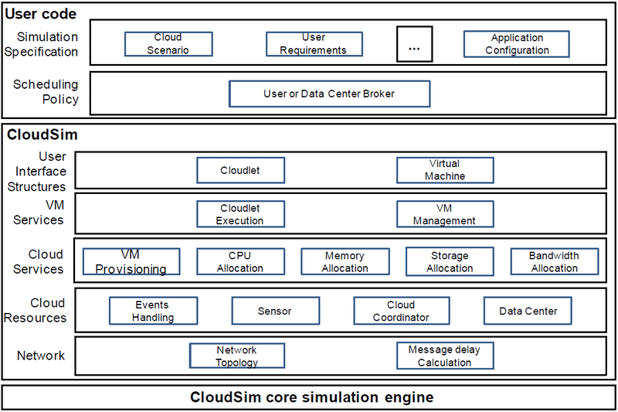
CloudSim Architecture

Slide 27
Contd…
The above diagram demonstrates the layered architecture of CloudSim Simulation Toolkit. The CloudSim Core simulation engine provides support for modeling and simulation of virtualized Cloud-based data center environments including queuing and processing of events, creation of cloud system entities (like data center, host, virtual machines, brokers, services, etc.) communication between components and management of the simulation clock.
The CloudSim layer provides dedicated management interfaces for Virtual Machines, memory, storage, and bandwidth. Also, it manages the other fundamental issues, such as provisioning of hosts to Virtual Machines, managing application execution, and monitoring dynamic system state(e.g. Network topology, sensors, storage characteristics, etc), etc.
The User Code layer is a custom layer where the user writes their own code to redefine the characteristics of the stimulating environment as per their new research findings.

Slide 28
Classes Of CloudSim
Cloudlet: This class model(define specific attributes such as length of instruction, input/output filesize, no of processor required, etc).
CloudletScheduler: This is responsible for the implementation of different policies that determine the share of processing power among Cloudlets in a VM. There are two types of provisioning policies offered: space-shared (using CloudetSchedulerSpaceShared class) and time-shared (using CloudletSchedulerTimeShared class).
Datacenter: This class model the core infrastructure-level services (i.e. hardware) that are offered by Cloud providers (Amazon, Azure, and App Engine). It encapsulates a set of hosts(resembling server machine model) instances that can either be homogeneous or heterogeneous concerning their hardware configurations (memory, cores, capacity, and storage).
DatacenterBroker or Cloud Broker: This class model a broker, which is responsible for mediating negotiations between SaaS and Cloud providers and such negotiations are driven by QoS requirements. The broker class acts on behalf of applications. Its prime role is to query the CIS to discover suitable resources/services and undertakes negotiations for the allocation of resources/services that can fulfill the application’s QoS needs. This class must be extended for evaluating and testing custom brokering policies.
DatacenterCharacteristics: This class contains configuration information of data center resources like the available host list, the fine-grained cost for each resource type, etc.

Slide 29
Contd…
Host: This class model a physical resource such as a computer or storage server. It encapsulates important information such as the amount of memory and storage, a list and type of processing cores (if it is a multi-core machine), an allocation of policy for provisioning the compute, memory and bandwidth to the VMs.
RamProvisioner: This is an abstract class that represents the provisioning policy for allocating primary memory (RAM) to Virtual Machines. The execution and deployment of VM on a host are feasible only if the RamProvisioner component approves that the host has the required amount of free memory. The RamProvisionerSimple does not enforce any limitation on the amount of memory that a VM may request. The RAM resource request will be rejected if it is beyond the available capacity.
BwProvisioner: The main role of this component is to undertake the allocation of network bandwidths to a set of competing VMs that are deployed across the data center.
Vm: This class model a Virtual Machine (VM), which is managed and hosted by a Cloud host component. Every VM component has access to a component that stores the following characteristics related to a VM (i.e.) accessible memory, processor, storage size, and the VM’s internal provisioning policy that is extended from an abstract class called the CloudletScheduler.
VmAllocationPolicy: This is an abstract class that represents a provisioning policy to be utilized by VM Monitor for mapping VMs to hosts.
VmScheduler: This is an abstract class implemented by a Host component that models the allocation policies (space-shared, time-shared) defining the rules for processor cores allocations to VMs.

Slide 30
Contd…
CloudSim: This is the prime class, with the role of managing entity event queues and controlling the sequential execution of simulation events.
SimEntity: This is an abstract class, which represents a simulation entity (such as DataCenter, DatacenterBroker, etc) ) that is able to send messages to other entities and processes received messages as well as fire and handle events. SimEntity class provides the ability to schedule new events and send messages to other entities, where network delay is calculated according to the BRITE model. Once created, entities automatically register with CIS. All entities must extend this class and override its three core methods: startEntity(), which define actions for entity initialization, processEvent(), which defines actions processing of each called event(s) with respect to the entity, shutdownEntity(),which define actions for entity destruction.
SimEvent: This entity represents a simulation event that is passed between two or more entities. SimEvent stores the following information about an event: type, init time, time at which the event should occur, finish time, time at which the event should be delivered to its destination entity, IDs of the source and destination entities, the tag of the event, and Data that have to be passed to the destination entity.
CloudSimShutdown: This is an entity class that waits for the termination of all end-user submitted cloudlets(tasks) and broker entities events, and once detected, then signals the end of simulation to CIS.

Slide 31
Steps to Implement
Initialize the CloudSim package. It should be called before creating any entities.
Create Datacenter(s) (Datacenter ←← DatacenterCharacteristics ←← HostList ←← ProcessingElementList)
(Define policy for VM allocation and scheduling)
Create Broker
Create Cloudlet(s) (Define workload)
Create VMs (Define the procedure for Task Scheduling Algorithm)
Starts the simulation (automated process, handled through created event simulation engine)
Print results when simulation is over (outputs)

Slide 32
Narration of CloudSim Example 1
CloudSim: Simulation Of Cloud Computing Infrastructures And Services
https://github.com/amelcharolinesgn2/CloudSim

Slide 33
can Experiment
By taking number of Cloudlets with varying length of instructions
By taking varying number of VMs (homogeneous or heterogeneous)
Also, can work on by taking some real world workloads
By taking number of hosts with different number of processing core(s)
By defining your own scheduling algorithm by modifying the code in bindtocloudlet() method of datacenterbroker.java class.
You can analyse and compare your own algorithm against other load balancing and scheduling algorithms by taking different performance metrics (such as, throughput, response time, resource utilization, makespan, degree of imbalance (DOI) etc.)
Can work on reduction of energy consumption by modifying in power package in CloudSim and so on…
It concludes, there are endless opportunity that you can work upon using CloudSim.

